Slide 1
INTRODUCTION
Fomba Kassoh
Souleymane Doumbia
Project Title: Determination of the best regression model to fit NYC COVID-19 data from 2021 and 2022.

Slide 2
Context of Data Collection
Data Overview
The analysis uses COVID-19 death count, case count and hospitalization count from NYC OpenData, available at NYC OpenData Portal and accessible via API or in downloadable CSV/JSON formats.
Data Collection Phases
Early Pandemic (Early 2020): Limited testing likely led to underreporting.
Mid-2020: Improved testing allowed comprehensive data collection, including test positivity rates and demographics.
Vaccination Rollout (Late 2020/Early 2021): Began collecting vaccination data with vaccine approval and administration.
Impact of Public Health Campaigns (2020-2021): Public health efforts influenced data trends, especially vaccination and prevention.
Adaptation to Variants (2021+): Monitoring intensified with the emergence of new variants to assess vaccine effectiveness.
Long-Term Monitoring (2021+): Focus on long-term COVID-19 impacts, vaccine efficacy, and public health policy effects.

Slide 3
Description Variables
Dependent Variable (death_count)
Serves as the outcome variable for predictions or explanations.
Denotes daily COVID-19 death numbers.
Independent Variables
hospitalized_count
Indicates daily COVID-19 hospitalizations, used to explain death count variations.
case_count
Reflects daily new confirmed COVID-19 cases, also to predict changes in death count.
Research Question
Investigates the influence of COVID-19 hospitalizations and case counts on the number of related deaths.

Slide 4
Abstract
Objective of the Analysis
Determine the best regression model for COVID-19 case data from 2021 and 2022.
Address the challenges of count data, such as right-skewness and overdispersion, unsuitable for standard linear models.
Preliminary Data Evaluation
Histograms, Q-Q plots, and boxplots showed non-normal distributions and outliers.
Q-Q plots indicated heavy-tailed distributions; scatter plots suggested nonlinear relationships.
Model Selection
Standard linear regression was unsuitable due to non-normal residuals and heteroscedasticity.
Explored Generalized Linear Models (GLMs) for their robustness to count data peculiarities.
Challenges with the Poisson Approach
Initial choice due to suitability for count data.
Found inadequate due to overdispersion and outliers, contradicting Poisson's equal mean-variance assumption.
Adopting the Negative Binomial Model
Introduced to handle overdispersion, showing improved fit and fewer influential outliers.
Provided more reliable estimates, better addressing the variance structure of COVID-19 data.
Overall Finding:
Negative Binomial regression is superior for epidemiological data with overdispersion and skewness.
Essential to consider the data's distribution in modeling to capture its complexities accurately.

Slide 5
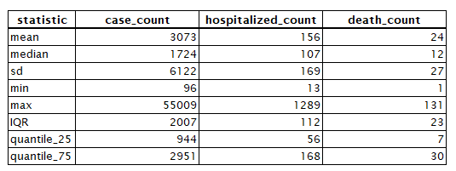
Summary Statistics
Suitability of data for regression modeling and inference
Large standard deviation relative to the mean suggests a wide variation in the daily counts
The substantial difference between the mean and median indicates a right-skewed distribution.
The interquartile range (IQR) and the significant difference between the 25th quantile and the 75th quantile also support the presence of skewness.
The maximum values are quite far from the 75th quantiles, suggesting outliers or extreme values.
Overall, the data can be used for regression modeling and inference, but care must be taken to choose the correct model form and address the issues of skewness and outliers

Slide 6
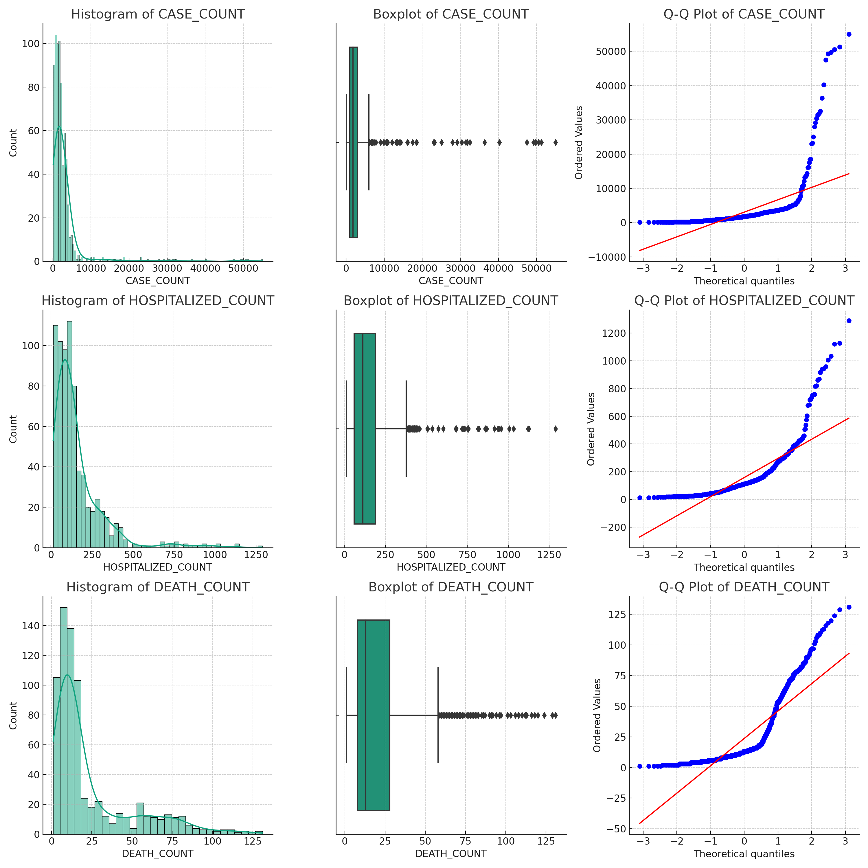
Appropriate Visualizations Suitability for Regression and Inference
Interpretation of plots
The histograms and box plots shows skewness of the data and the presence of outliers.
The Q-Q plots suggest that none of the variables follow a normal distribution.
The presence of outliers and the skewness indicate that the assumptions of normality and homoscedasticity (constant variance) for linear regression are likely violated.
This non-normality means that assumptions required for certain statistical inference methods and for linear regression may not be met.

Slide 7
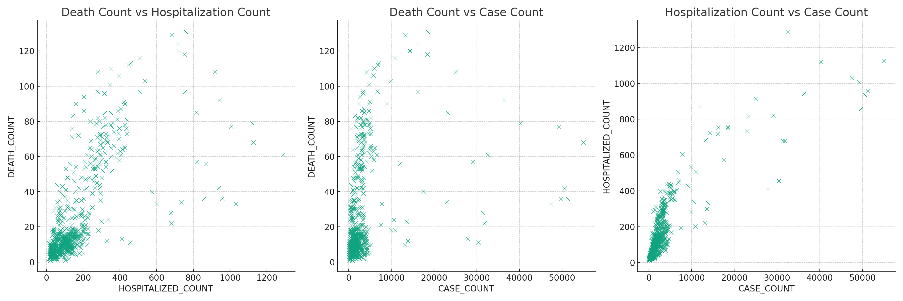
Appropriate Visualizations Suitability for Regression and Inference
Interpretation of plots
The scatter plots of COVID-19 data indicate positive relationships between death counts and both hospitalization counts and case counts.
The association between deaths and hospitalizations appearing stronger.
These trends suggest that regression modeling could reveal significant predictive relationships, informing public health responses.

Slide 8


Hypothesis Testing Validation of Suitability for Regression and Inference
Hypothesis Statement
Null Hypothesis (H0): There is no statistical association between the number of hospitalizations and the number of deaths due to COVID-19. Any observed association in the data is due to random chance.
Alternative Hypothesis (H1): There is a statistically significant association between the number of hospitalizations and the number of deaths due to COVID-19. The observed association is not due to random chance.
Pearson’s Correlation
Spearman’s Correlation
More suitable for count data
Interpretation Hypothesis Testing
Given the p-value is less than 0.05, we reject the Null Hypothesis (H0).
That is, there is statistically significant evidence to suggest an association between the number of hospitalizations and the number of deaths due to COVID-19.
The correlation coefficient suggest that as hospitalizations increase, deaths tend to increase as well, and this relationship is not due to random chance.

Slide 9
Now that we have proven that there is a relationship to model, let us explore which model is most suitable

Slide 10
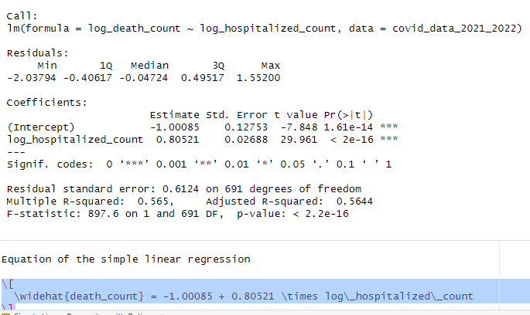




Simple Linear Regression
Model Output & Equation
Statistical Significance
The p-value is significantly less than 0.05 indicating that hospitalization count is a statistically significant predictor of the death count.
Practical Significance
The coefficients for log_hospitalized_count is 0.80521. These value is substantial, suggesting that changes in the predictors have a notable effect on the expected number of deaths.
Model Fit
The R-Squared of 0.565 suggests a moderate level of explanation, implying that the model has a reasonable fit to the data. However, nearly half of the variation is still unexplained by the model.

Slide 11
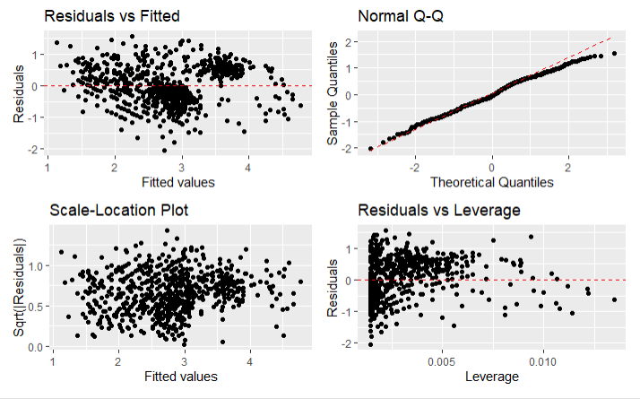
Simple Linear Regression
Residuals vs Fitted
The Residuals vs Fitted plot shows a funnel pattern, indicating heteroscedasticity and suggesting that a simple linear regression model may be inappropriate.
Model Diagnostics
Normal Q-Q
The plot's slight deviation from the line at both tails suggests that the residuals are not perfectly normally distributed, which could indicate outliers or skewness in the data.
Scale-Location (Spread-Location)
The spread of residuals widening from left to right suggests non-constant variance, consistent with heteroscedasticity seen in the Residuals vs Fitted plot.
Scale-Location (Spread-Location)
Most data points exhibit low leverage with a few exceptions; however, those with higher leverage do not show large residuals, implying minimal influence on the regression line.

Slide 12
Simple Linear Regression
Overall Interpretation
Given the above diagnostic results, an addition of another variable or a different type of regression model that accounts for heteroscedasticity and non-normality, might be more appropriate.
Next, we will look at the “Multiple Linear Regression Model”

Slide 13
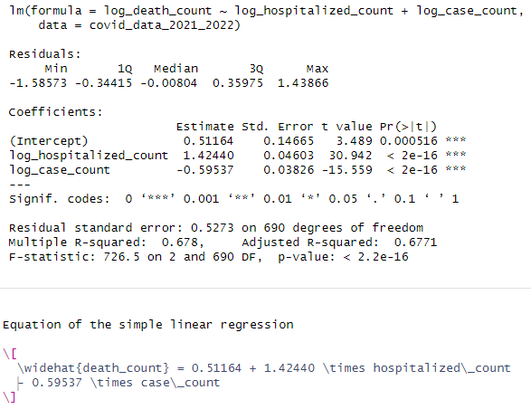




Multiple Linear Regression
Model Output & Equation
Statistical Significance
Both 'hospitalized_count' and 'case_count' have p-values much less than 0.05, indicating that their relationships with 'death_count' are statistically significant.
Practical Significance
The 'hospitalized_count' has a notably positive impact, while the negative coefficient of 'case_count' hints at a nuanced relationship possibly affected by healthcare dynamics and case severity changes.
Model Fit
The 'Multiple R-squared' of 0.678 indicates the model explains 67.8% of 'death_count' variability, demonstrating a robust improvement over the simple linear model.

Slide 14
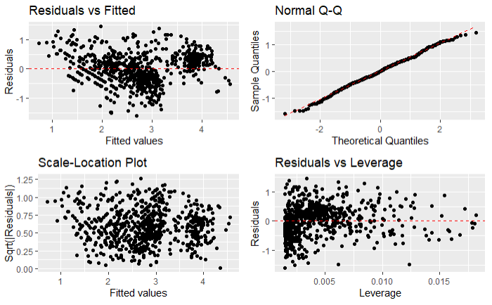
Multiple Linear Regression
Residuals vs Fitted
The Residuals vs Fitted plot suggests possible deviations from linearity or the presence of heteroscedasticity, indicating that the model may not capture all the complexity of the data.
Model Diagnostics
Normal Q-Q
The Normal Q-Q plot indicates that the residuals are mostly normally distributed, which is a good sign for the reliability of coefficient estimates and the overall model.
Scale-Location (Spread-Location)
The Scale-Location plot suggests that the variance of residuals is relatively constant, with potential slight heteroscedasticity for larger fitted values.
Scale-Location (Spread-Location)
The Residuals vs Leverage plot does not show any particular points that would be considered highly influential or problematic for the model.

Slide 15
Multiple Linear Regression
Overall Interpretation
Overall, while the diagnostic plots indicate the model fits the data reasonably well, there may be room for improvement, possibly by considering non-linear models to better capture the underlying relationships in the data.
Next, we will look at the “Generalized Linear Models.”
Since death count is a count variable, a Poisson or negative binomial regression, which are suitable for modelling count data may provide a better fit

Slide 16
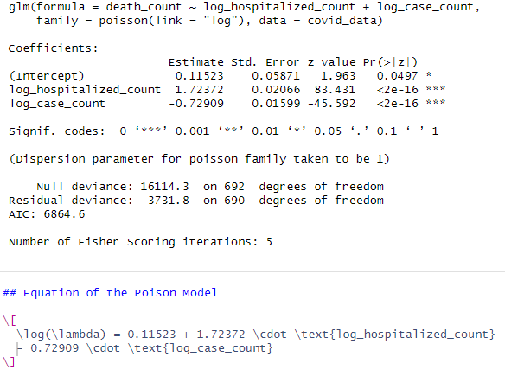


Generalized Poisson model
Statistical Significance
The model shows statistical significance as indicated by the p-values.
Model Output & Equation
Practical Significance
The positive coefficient for log_hospitalized_count indicates a significant increase in expected deaths with more hospitalizations, while the negative coefficient for log_case_count implies a decrease in the death rate as case numbers grow, possibly due to better treatment or detection of milder cases.
Model Fit
The model with predictors significantly outperforms the intercept-only model, fitting the data well as indicated by the reduced deviance and positive coefficients, though further comparisons and enhancements could refine it further.

Slide 17
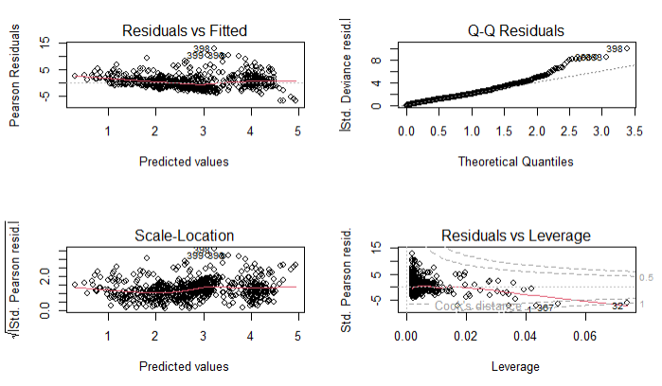
Generalized Poisson model
Residuals vs Fitted
In this plot, there seems to be a funnel shape with a wider spread of residuals as the fitted values increase, indicating potential overdispersion or a non-linear relationship not captured by the model.
Model Diagnostics
Normal Q-Q
The points in the plot follow the line closely except for the upper tail suggesting that high values may not be fitting as well, which could also be a sign of overdispersion.
Scale-Location (Spread-Location)
The plot indicates that variability of the residuals increases with the fitted values, another potential sign of overdispersion.
Scale-Location (Spread-Location)
In this plot, there don't appear to be any points beyond the Cook's distance lines, suggesting there are no highly influential outliers.

Slide 18
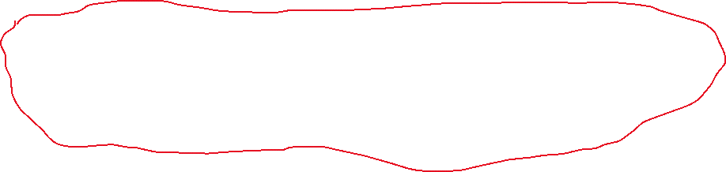
Generalized Poisson model
Overall Interpretation
Based on the diagnostics:
The Poisson model exhibits overdispersion and potential non-linearity, as suggested by the funnel shape in the Residuals vs Fitted plot and increased variability in the Scale-Location plot.
The Normal Q-Q plot indicates possible issues with high-value fits, reinforcing concerns about overdispersion.
The absence of influential outliers in the Residuals vs Leverage plot is positive, but overall, signs point towards the Negative Binomial model as a better fit for the overdispersed data.

Slide 19
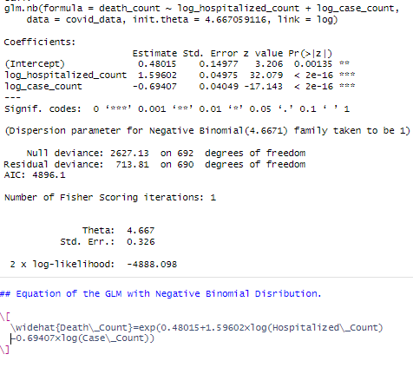



Negative Binomial Distribution
Model Output & Equation
Statistical Significance
The low p-values for the coefficients suggest that the model is statistically significant in predicting the death_count variable.
Practical Significance
The magnitudes of the coefficients (1.59602 for hospitalized count and -0.69407 for case count) are substantial, especially given that they are on a logarithmic scale. This implies that changes in the log of hospitalized and case counts have meaningful impacts on the death count.
Model Fit
The significant drop from a Null Deviance of 2627.13 to a Residual Deviance of 713.81, along with a lower AIC of 4896.1, indicates a well-fitting model with a substantial improvement over the baseline.

Slide 20
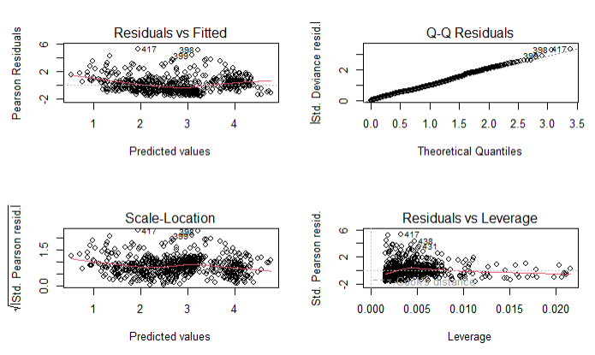
Negative Binomial Distribution
Residuals vs Fitted
The plot shows a random scatter of residuals around the horizontal line, which is good. However, some points are lying outside the expected range, which could be outliers or indicate overdispersion.
Model Diagnostics
Normal Q-Q
The clear deviation at the upper tail indicates that the residuals have heavier tails than expected if they were normally distributed, which is common for count data and consistent with the negative binomial distribution's allowance for overdispersion.
Scale-Location (Spread-Location)
The plot indicates increasing spread with the fitted values, suggesting some degree of heteroscedasticity.
Scale-Location (Spread-Location)
The plot shows a few points with higher leverage, but they do not coincide with large residuals, suggesting they may not be having a significant influence on the model.

Slide 21
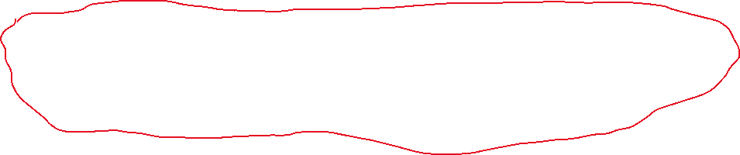
Negative Binomial Distribution
Overall Interpretation
Based on the diagnostics:
The Negative Binomial regression model emerged as the most appropriate, addressing the overdispersion and skewness typical in count data, which standard linear and Poisson models failed to accommodate.

Slide 22
Conclusion
Importance of the Analysis
This analysis is crucial as it enhances our understanding of COVID-19's impact and informs public health responses.
By scrutinizing daily counts of cases, hospitalizations, and deaths from 2021 to 2022, the study aimed to identify a statistically robust model that accurately captures the relationships within the data.
The Negative Binomial regression model emerged as the most appropriate, addressing the overdispersion and skewness typical in count data, which standard linear and Poisson models failed to accommodate.
Limitations of the Analysis
The study has several limitations:
It excludes important factors like demographics and healthcare access.
Limited to a specific period, lacking time-series analysis, which could reveal trends.
Assumes independent observations, which may not apply in interconnected epidemiological data.
The findings, while advancing COVID-19 data modeling, are limited by the range of variables and assumptions used. Future work could enhance the analysis by including more variables and using more complex modeling techniques.

Slide 23
THE END
Thanks for listening
Feedback & Question

